Slide 1
CUSTOMER DATA ANALYSIS PROJECT
NAME : SWATHI
COURSE : CDA

Slide 2
Project objective
the objective of this project is to analyse customer shopping behaviour using Power BI and generate business insights through interactive dashboards and visualizations.

Slide 3
dataset information
The dataset contains customer transaction details including customer ID, gender, age, product category, quantity, payment method, invoice date, shopping mall, and total sales. The dataset contains approximately 1 lakh rows.

Slide 4
Data cleaning & DAX
The dataset was connected from MYSQL workbench to Power BI for analysis. Data cleaning and transformation were performed using power query. Data types were checked and corrected, null values were verified, duplicate values were analyzed, and a total sales column was created for analysis.
DAX measures such as total sales, total orders, and total customers were created to build KPI cards and dashboard visualizations.

Slide 5
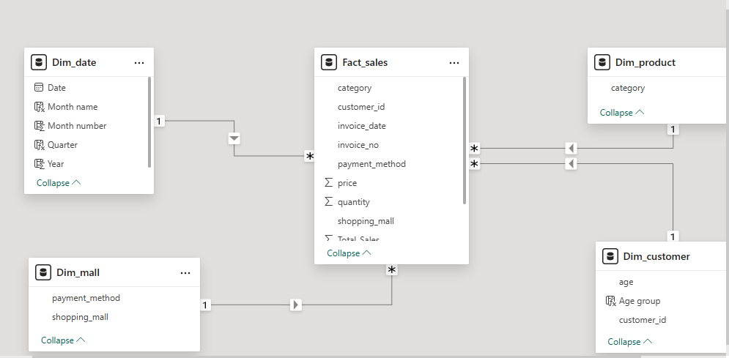
Data model
The data model was created using a star schema approach in Power BI. Fact_sales we connected with dimension tables such as Dim_customer, Dim_product, Dim_mall, and Dim_date using relationships. This model improved data organization and analysis performance.

Slide 6
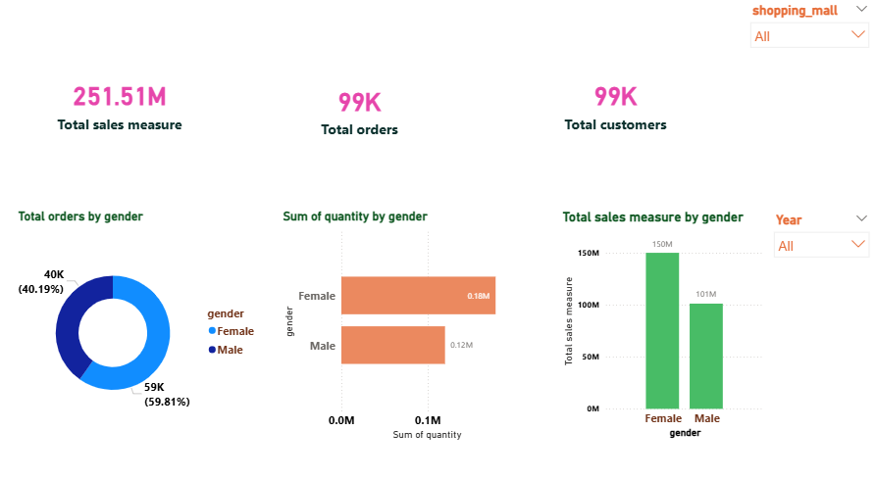
Dashboard analysis – Gender analysis
The above dashboard page focuses on gender-based customer shopping analysis Revenue distribution, shopping distribution, and product purchases were analyzed based on gender

Slide 7
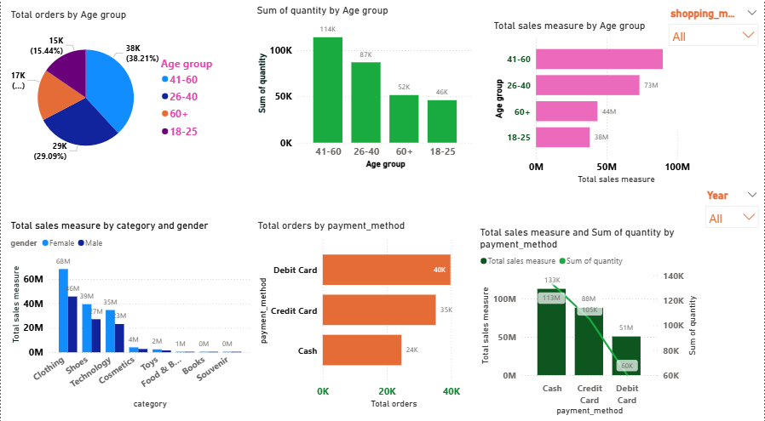
Dashboard analysis – category and payment analysis
The above dashboard page focuses on age group analysis, category analysis, and payment method analysis using different visualizations and interactive charts.

Slide 8
Key Insights
female customers contributed a significant portion of total sales revenue.
Customers aged 26 -40 generated higher revenue.
Clothing category showed strong sales performance.
Credit card and cash were the most commonly used payment methods.
Shopping behavior varied across shopping malls and years.

Slide 9
conclusion
This project successfully analyzed customer purchasing behavior using Power BI dashboards and visualizations. The generated insights can help business understand customer preferences and improve business decision-making.

